Slide 1
Shaping the future of our Community with Shared Services
Presented by Mosquito Fire Protection District Board

Slide 2

Welcome
Mosquito Fire Protection District
Located in El Dorado County
Established in 1978 – Station 75
Providing Fire Protection and Emergency Medical Services covering approx. 13 square miles for approx. 2000 residents
8801 Rock Creek Rd, Placerville, CA 95667
Combination Paid and Volunteer staff
Governed by a 5 member District Board Of Directors and overseen by El Dorado Local Agency Formation Commission (LAFCO)

Slide 3

Garden Valley Fire Protection district
Located in El Dorado County
Established in 1973 – Station 51 (Headquarters), Station 52 and Station 53
Providing Fire Protection and Advanced Life Support through Squad 51 covering approx. 60 square miles locally and more than 400 square miles on the Divide for approx. 8,100 residents locally and a population of over 25,000 regionally
Combination Model: Maintaining a minimum daily baseline of one Captain and one Chief Officer 24/7, supported by a dedicated roster of volunteer firefighters
Governed by a 5 member District Board Of Directors and overseen by El Dorado Local Agency Formation Commission (LAFCO)

Slide 4
Shared Services with Garden Valley Fire Protection District

Slide 5
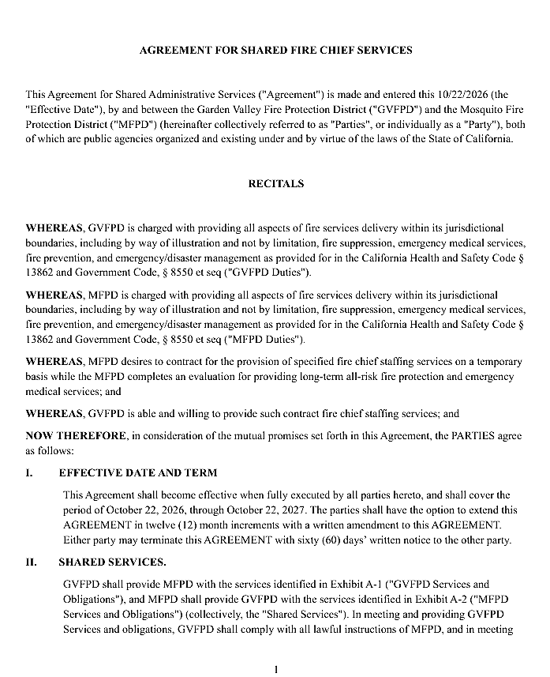
Shared Services Summary
PAGE 1
Shared Services between Garden Valley Fire Protection District and Mosquito Fire Protection District consists of:
MFPD hiring GVFPD Chief as MFPD Chief
GVFPD Chief Norman is shared amongst three districts consisting of MFPD, GVFPD and Georgetown.
Item I.
This agreement is for a one year term. (dates will be amended for date of signing)
This agreement can be cancelled by either MFPD or GVFPD with 60 days written notice.
Item II
MFPD remains responsible for MFPD and MFPD Shared Chief will govern MFPD according to MFPD policy under this agreement.
CONCEPTUAL

Slide 6
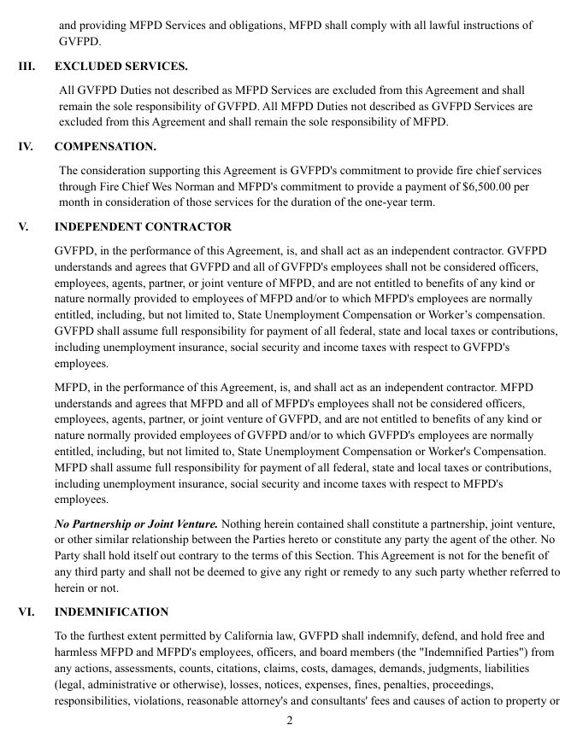
Page 2
Item III
Excluded services are those that are not in this agreement.
GVFPD will remain governed by GVFPD board and policy.
MFPD will remain governed by MFPD board and policy.
Item IV
This one year agreement is for fire chief services from GVFPD Chief Wes Norman and will cost MFPD $6,500 monthly for the duration of the one year.
Item V
GVFPD is an independent contractor in this agreement.
GVFPD employees and volunteers remain GVFPD employees and volunteers and are responsible for GVFPD duties.
MFPD employees and volunteers remain MFPD employees and volunteers and are responsible for MFPD duties.
Shared services are NOT consolidation, this is NOT a partnership or joint venture
CONCEPTUAL

Slide 7
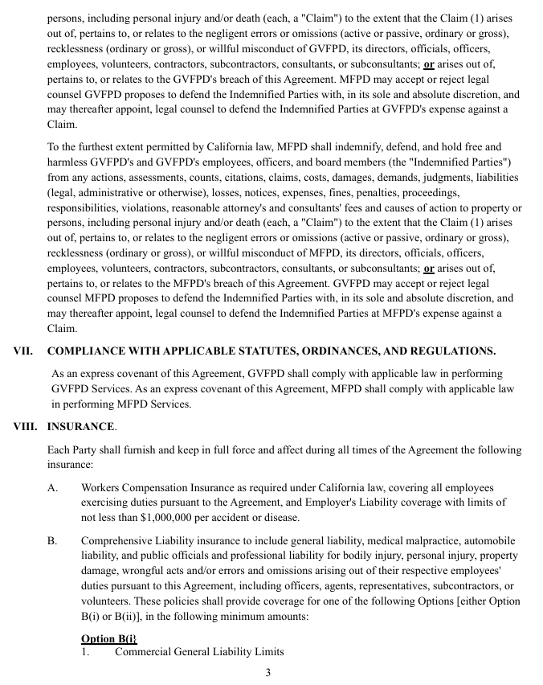
PAGE 3
Item VI
Indemnification
MFPD is responsible for all MFPD finances, insurance, and legal responsibilities and agrees to hold GVFPD harmless from financial liability, losses or damages resulting from shared services and vice versa.
Item VII
Both MFPD and GVFPD agree to uphold and be compliant with applicable law.
Item VIII
Each district will remain in compliance with current insurance and will remain responsible for insuring their own districts as listed out in this agreement.
A - Workers compensation. No significant change, if any, will most likely be less cost.
B - Comprehensive Liability laid out in two options for minimum amounts.
CONCEPTUAL

Slide 8
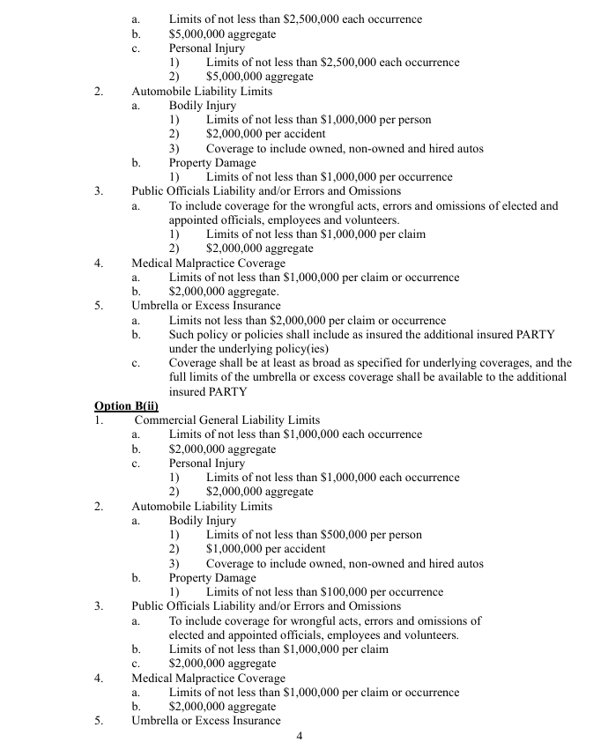
Page 4
Item VIII Cont.
The option of insurance will be confirmed after the shared services are able to move forward in an official capacity.
MFPD does not see that insurance costs will change drastically under shared services as these insurance options are similar to the current insurance of MFPD.
CONCEPTUAL

Slide 9
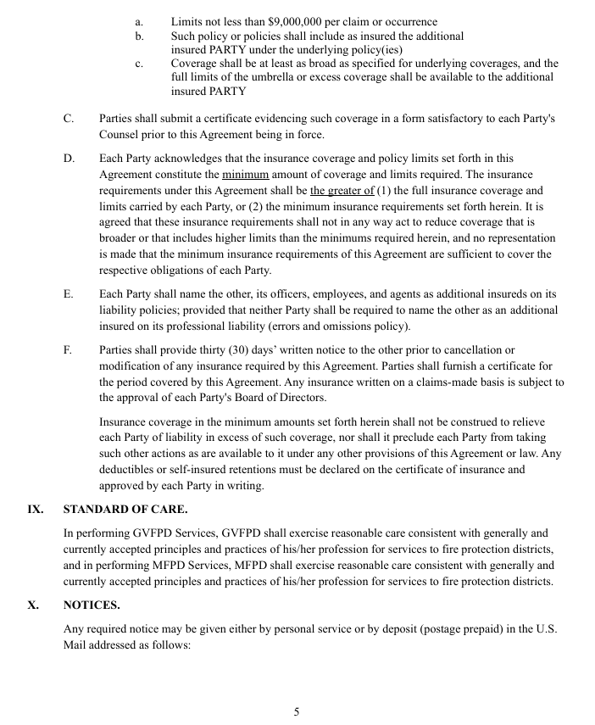
PAGE 5
Item XIII Cont.
C - Certificates have been obtained by the districts, however they may need to be reevaluated for final draft of this shared services agreement.
D – The insurance agreed upon in this agreement is the minimum amount of coverage and limits required.
E – both MFPD and GVFPD will have each other and their officers and employees and agents as additional insured on their liability policies.
F – Any changes to insurance listed in the agreement requires 30 days notice of change to the other district.
Item IX
Standard of care. These firefighters have a code of ethics they operate by and vow to uphold for their profession, including the chief.
CONCEPTUAL

Slide 10
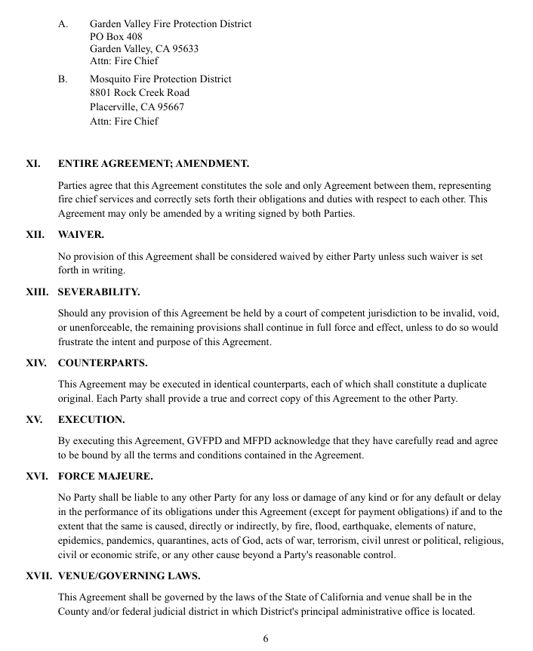
Page 6
Item X
Notices are to be sent to listed addresses
Item XI
This agreement is the only agreement for shared services between GVFPD and MFPD.
This agreement can only be changed by another written agreement signed by both GVFPD and MFPD
Item XII
There is no waiver of this agreement, and if so, must be in writing
Item XIII
Should a court of law find any part of this agreement defective or illegal, the remainder of the agreement remains intact
Item XIV
Both MFPD and GVFPD will have a duplicate original signed copies of this agreement
Item XV
Both MFPD and GVFPD acknowledge that both districts have read and agree to be bound by all terms and conditions of shared services agreement
Item XVI
For extraordinary and unforeseeable events no party shall be liable for the others loss or damage or delay
Item XVII
MFPD and GVFPD are in the state of California and are in the county of El Dorado and are under those state and county laws
CONCEPTUAL

Slide 11
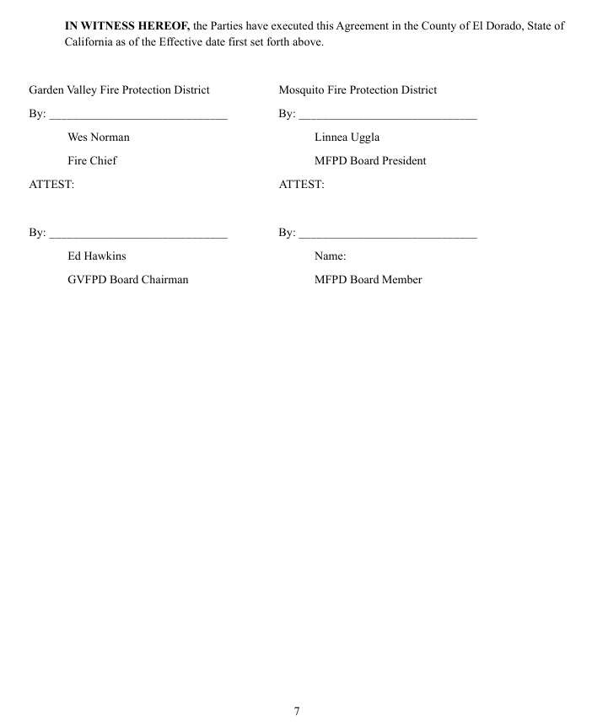
PAGE 7
If this agreement is signed after local elections, names may need to be edited to reflect correct Board Representatives in both districts.
CONCEPTUAL

Slide 12
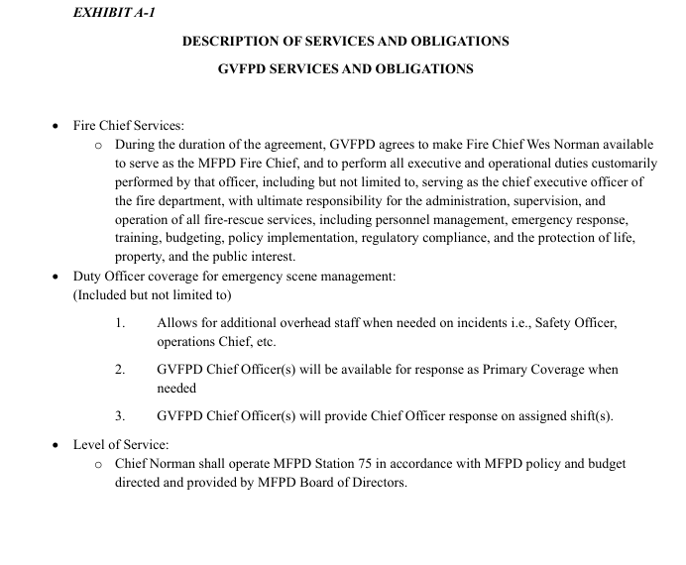
Page 8
Exhibit A-1 - Mentioned in Item II on page one
This shared service agreement is for GVFPD Chief Norman to be shared with MFPD as MFPD Chief Executive Officer
Duty officers from GVFPD are allowed and available to be additional staff when MFPD cannot staff from MFPD staff
Employees do not switch payrolls when crossing district borders
Duty Officer coverage sent to MFPD will be paid by the employee’s home agency payroll and reimbursed by MFPD
Again, no changes are being made to authority reach or policy of MFPD.
MFPD is simply hiring GVFPD Chief Wes Norman as MFPD Chief.
CONCEPTUAL

Slide 13
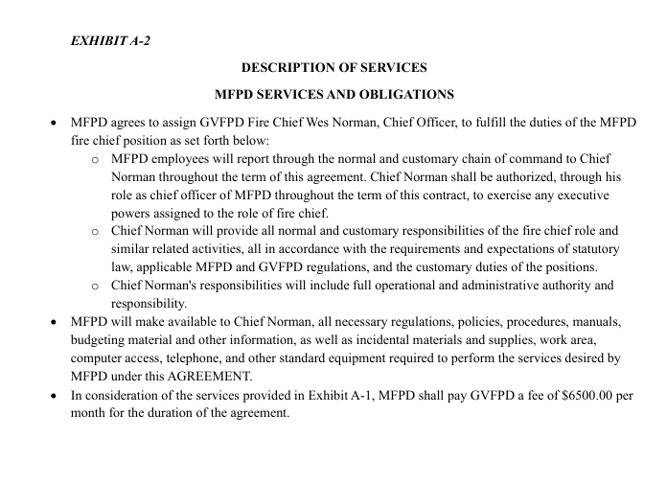
PAGE 9
Exhibit A-2 -
MFPD agrees to hire and assign GVFPD Chief Norman as MFPD Chief to have full operational and administrative authority and responsibility as laid out in accordance with this agreement and MFPD Policy
Chief Norman has full authority to exercise any executive powers assigned to the role of fire chief
MFPD will make all necessary information and records available for Chief Norman
Again, clearly stated that MFPD is hiring GVFPD Chief as MFPD Chief and will pay $6,500 monthly for the duration of this one year agreement
CONCEPTUAL

Slide 14
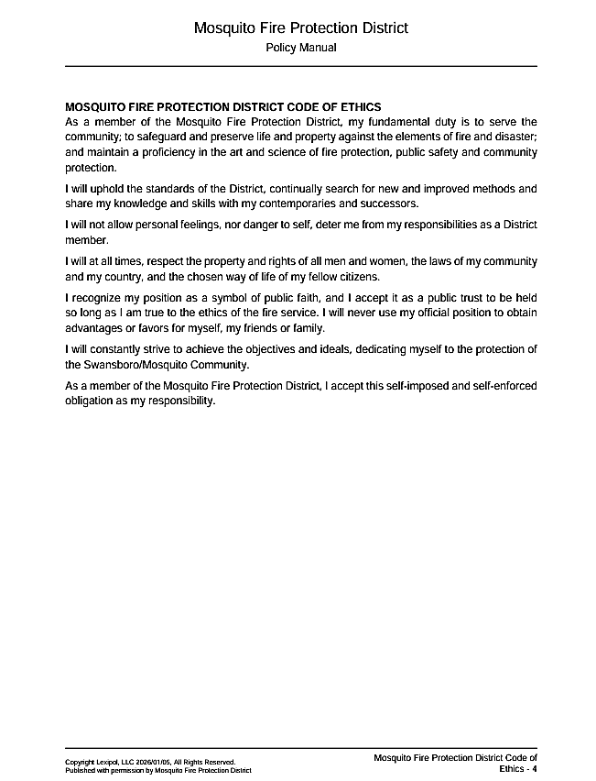

Slide 15
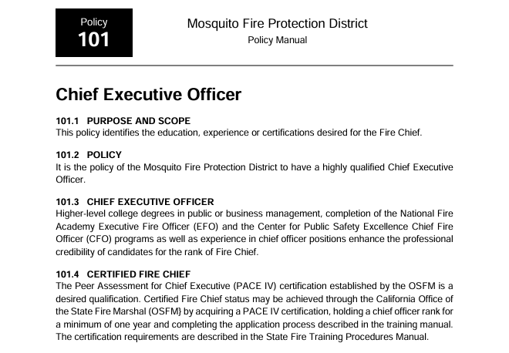

Slide 16
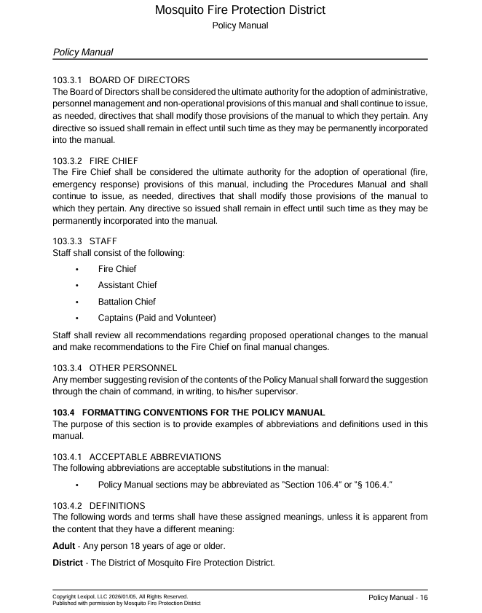

Slide 17
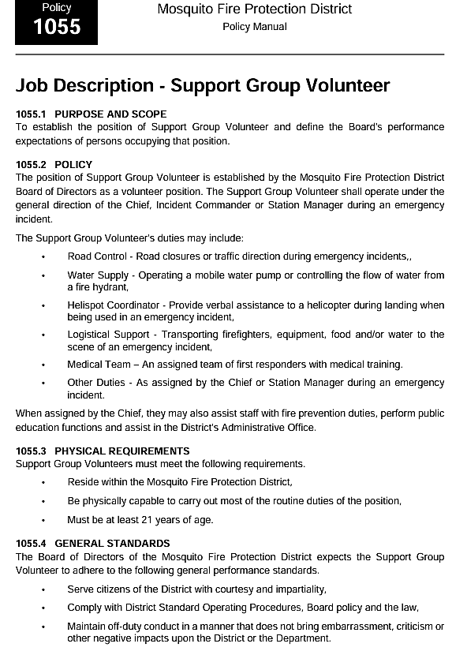
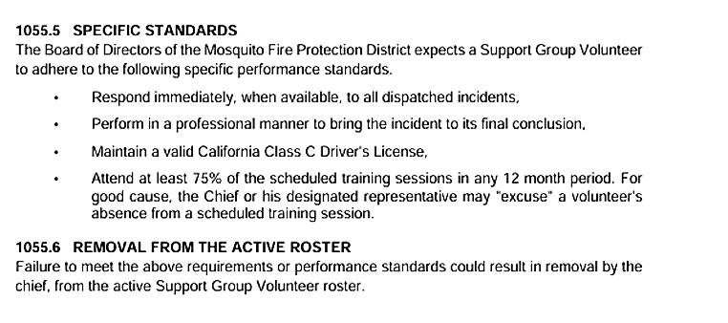
Support Group Volunteers
Support Group is a special group of trained volunteers in Mosquito. This group of volunteers work alongside the firefighters and are apart of MFPD Policy.
Chief Norman will lead MFPD according to MFPD policy which therefore includes Support Group Volunteers.
Support Group Volunteers operate under the general direction of the chief, Incident Commander or Station Manager during an emergency incident.

Slide 18
What brought us here?

Slide 19
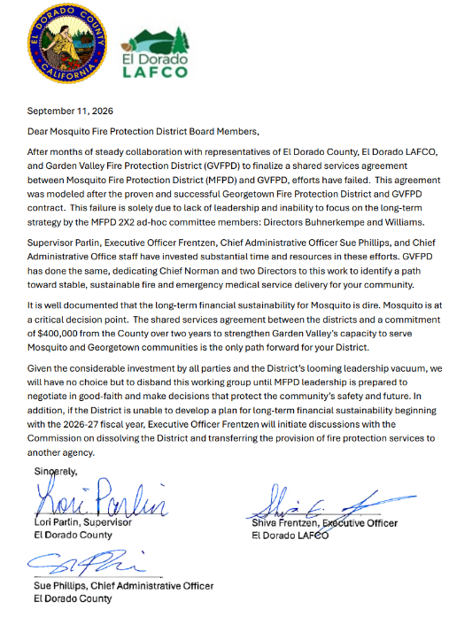
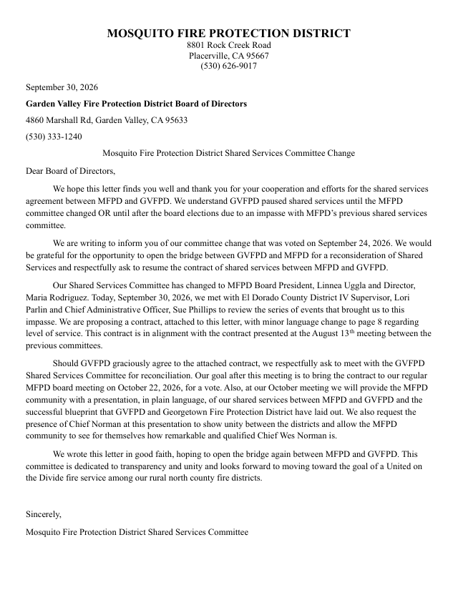
Quote

Slide 20
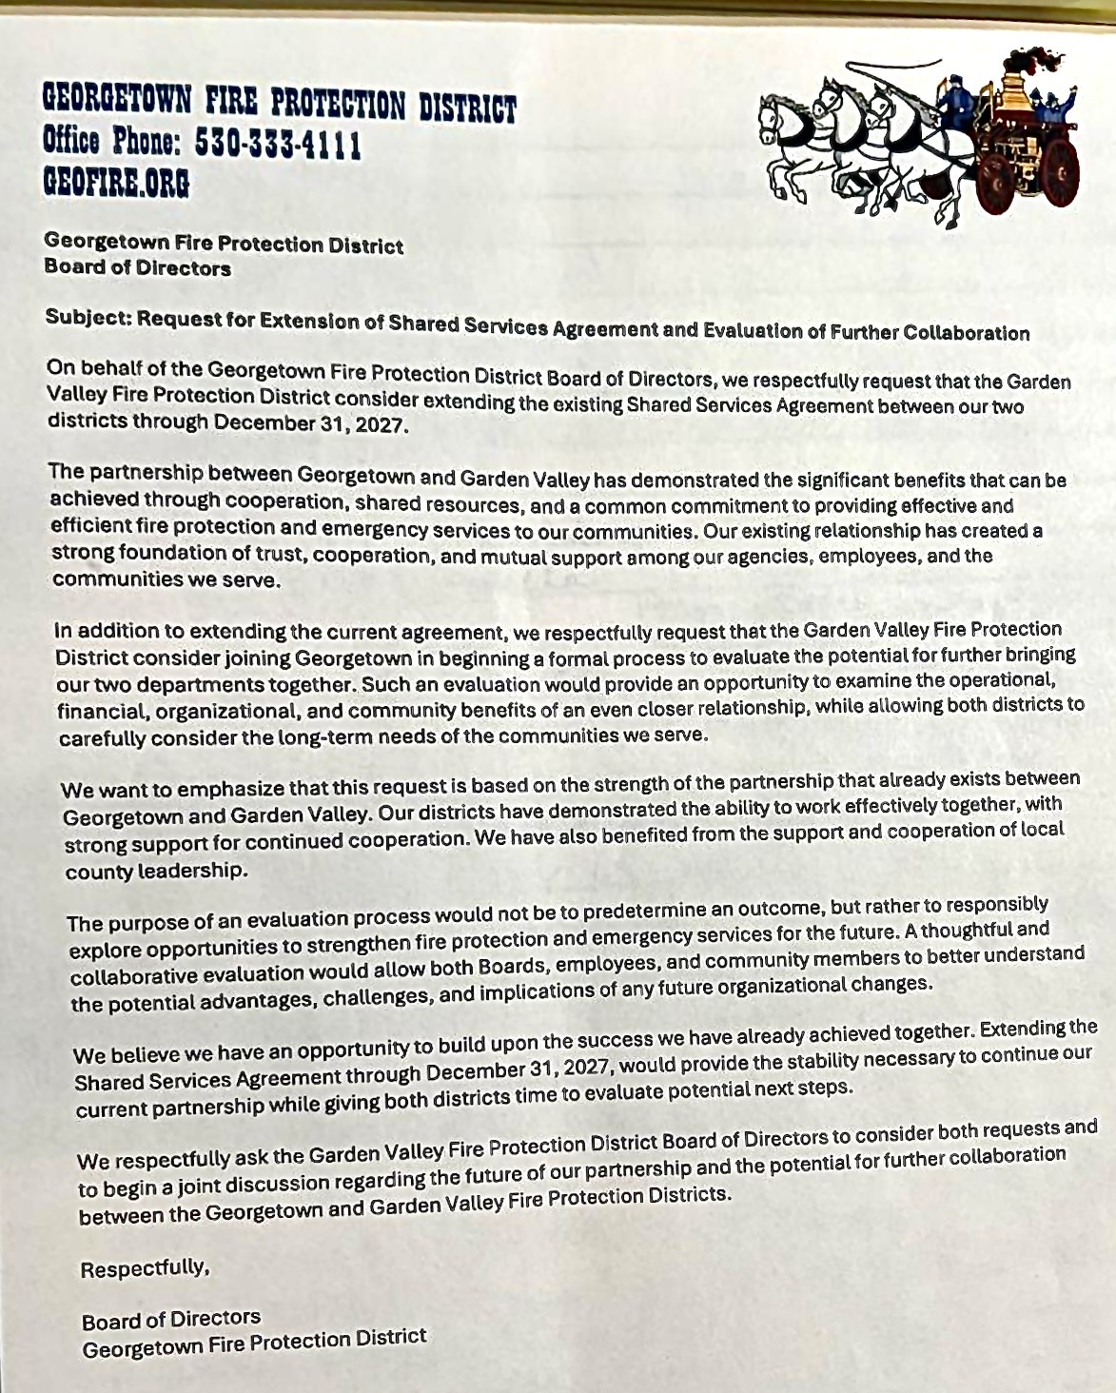

Slide 21
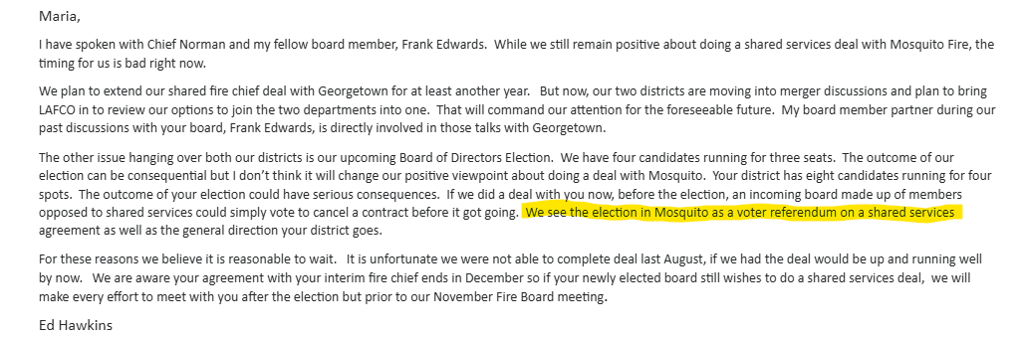

Slide 22
Where do we go from here?

Slide 23


welcome change.
Shape the future.
The fire service is changing and those who adapt and come together will be the ones to thrive.
Let the shared services agreement be the leading light into a brighter future for our community on the Divide.

Slide 24
5 Minute Intermission before Discussion and Vote
Presentation is over.
Thank you for your attention to this critically important district matter.
The Board meeting will resume session, public comment and vote on this item to commence after intermission.

